Slide 1
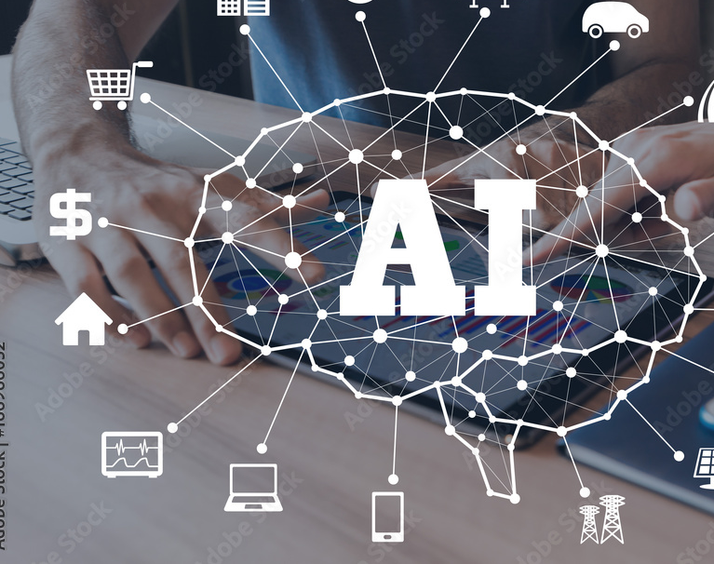
Exploring the Pros & Cons of Using Artificial Intelligence in Small Business

Slide 2
What is Artificial Intelligence?

Slide 3
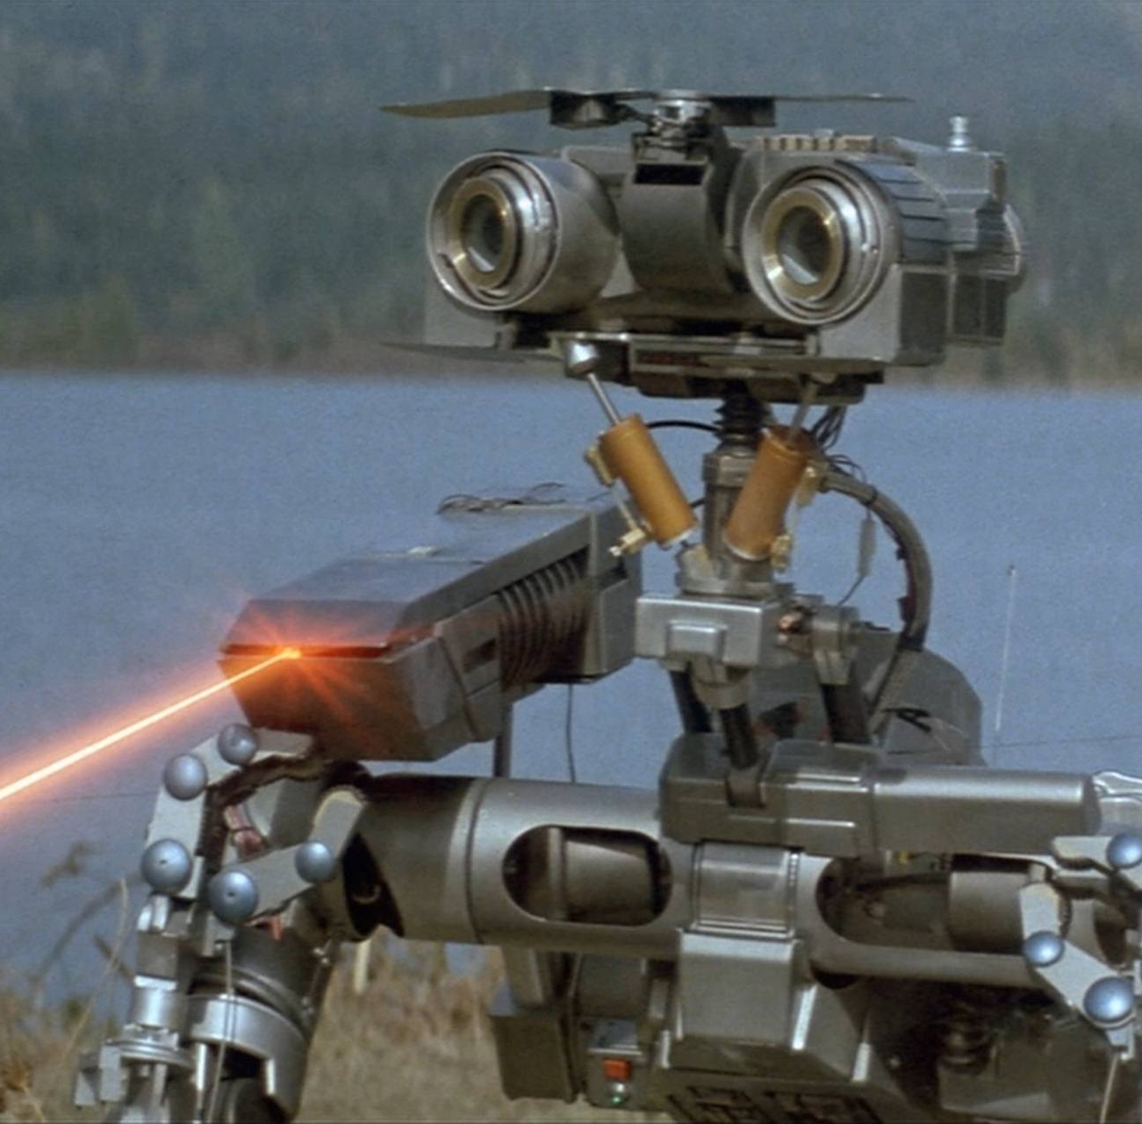
THE MACHINES ARE TAKING OVER!!
Notes:
Most people think of Skynet and that machines will overthrow the world.

Slide 4
What is AI & how does it work?
Artificial intelligence is the simulation of human intelligence processes by machines, especially computer systems. Specific applications of AI include expert systems, natural language processing, speech recognition and machine vision.
In general, AI systems work by ingesting large amounts of labeled training data, analyzing that data for correlations and patterns, and using these patterns to make predictions about future states.
Notes:
Simple Explanation: AI is when you make a computer like a little brain. You help it to learn by giving it a lot of words and pictures and numbers. If the computer hears you answer a lot of questions, later on it can quickly answer your questions.
4 types of AI:
Reactive-Task specific, no memory (Netflix Rec)
Limited Memory-Smarter as it receives data (Smart Cars)
Theory of Mind-Understanding of other entities thoughts and emotions
Self Awareness-Understanding of their own existence (I’m hungry to I know I am hungry and I want to eat pie since it is my favorite)

Slide 5
AI Statistics and Trends
Up to 25% of small business already use AI in one form or another
Out of 300 billion emails sent everyday, Machine learning detects at least half as spam
In 2020, chatbots responded to 85% of customer services interactions
The number of enterprises using AI in business grew by 270% between 2015 and 2019

Slide 6
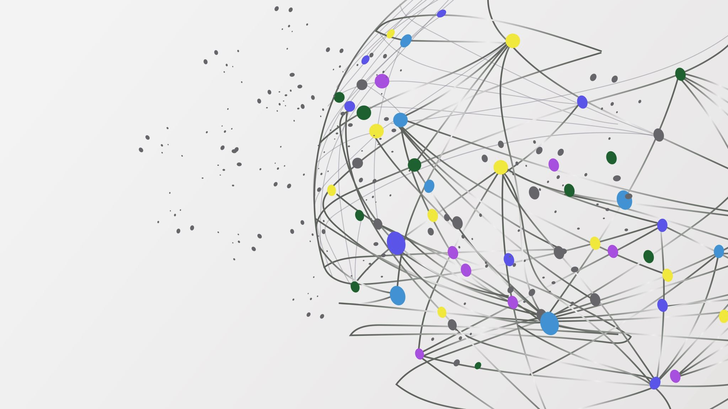
Bringing AI into your Small Business

Slide 7
Benefits of AI for Small Business
Improved Efficiency & Productivity
Enhanced Customer Service
Better Decision-making
Cost Reduction
Increased Revenue
Notes:
- AI can automate repetitive tasks, freeing up time for employees to focus on more strategic work.
- AI can analyze data and provide insights that can help businesses streamline their operations.
- AI can also help businesses optimize their workflows, reducing waste and improving overall efficiency.

Slide 8
Ways AI Can Help My Business

Slide 9
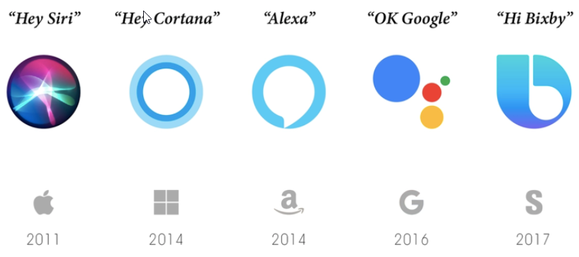
General Management
Appointment
*You Can Book Me Calendly
Email Management
*Boomerang Hiver
Social Media Management
*Constant Contact
Administrative
*Siri, Alexa, and Google Assistant
Notes:
Examples You have a small business that relies on scheduling. AI can see everything on you calendar and send you reminders about important dates and can help your customers with scheduling and reminders for their appointment
Your business has a lot of email correspondence and it is hard to keep track. AI can scan you incoming email and prioritize the important ones and can help remind you to follow up with emails that have gone unread
Having a hard time creating content for your social media. AI can help you create the content and can help you track who is your core audience so you can pinpoint your message
Voice assistance that you use everyday can help you with automation of tasks with AI speech recognition.

Slide 10
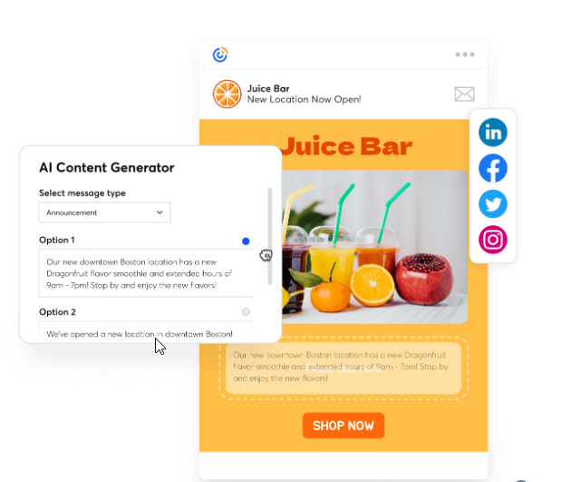
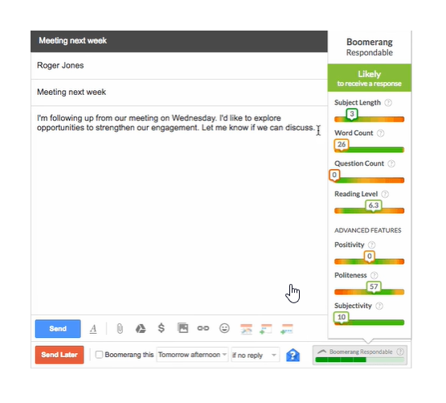
General Management

Slide 11
Accounting
Bookkeeping
*Wave Quickbooks
Financial Analysis
* Spotlight Reporting ClicData
Expense Management
*Expensify Zoho Expense
Notes:
Examples: AI can help with tracking an logging your transactions to help keep your books up to date
With the help of AI you can make better decisions concerning your business. Can help you with planning to order your stock bay tracking lead times and can help you make decisions on when to release you product to make the best impact.
AI can help you with tracking your expenses for your business. Have a hard time tracking your receipts you can just take a picture of the receipt an your AI can log the transaction and can learn from previous transactions without much input from the business owner

Slide 12
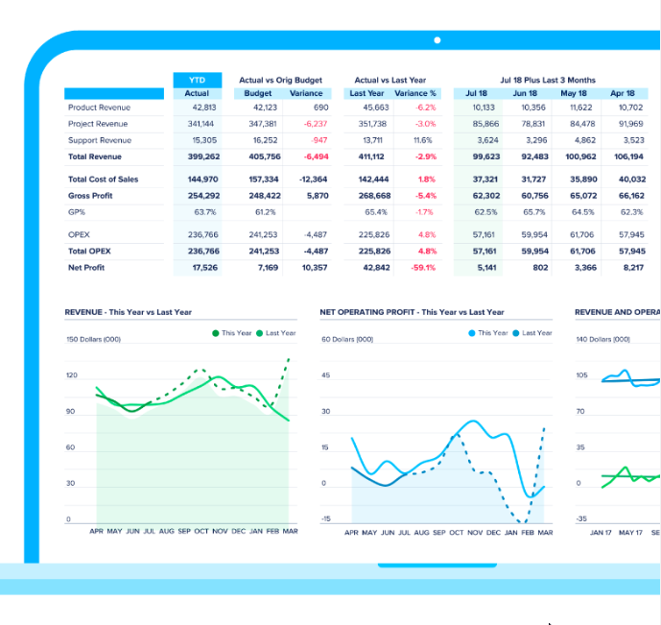
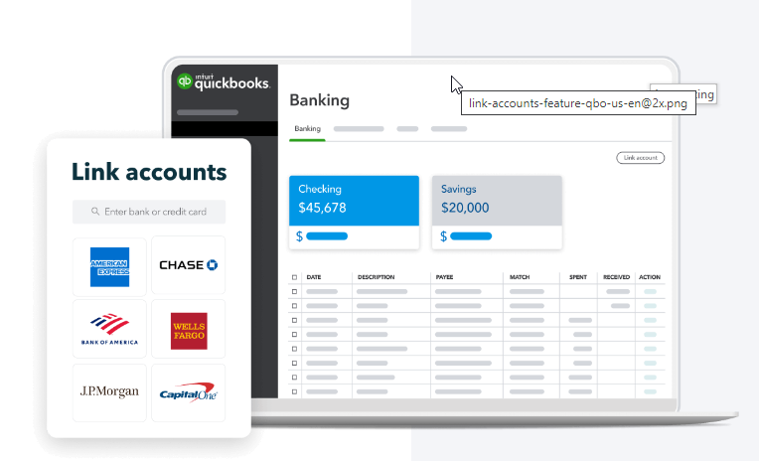
Accounting

Slide 13
Customer Service
Chatbots
*Intercom Birdeye
Personalization
*Segment Insider
Customer Insights
*Adobe Insights Resonate
Notes:
Examples: You are able to answer your customers questions on shipping times, item availability, order status anytime of day
If your customer is buying a grill kit your AI can help offer a grill cover that other customers of yours has ordered (Amazon)
Track that your customer regularly orders a hand lotion and can send a special promotion that is personalized for that customer (thank you for loyal customer)

Slide 14
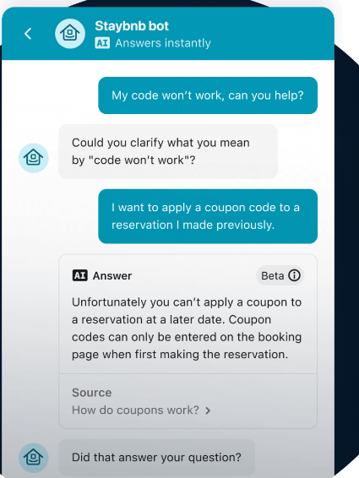
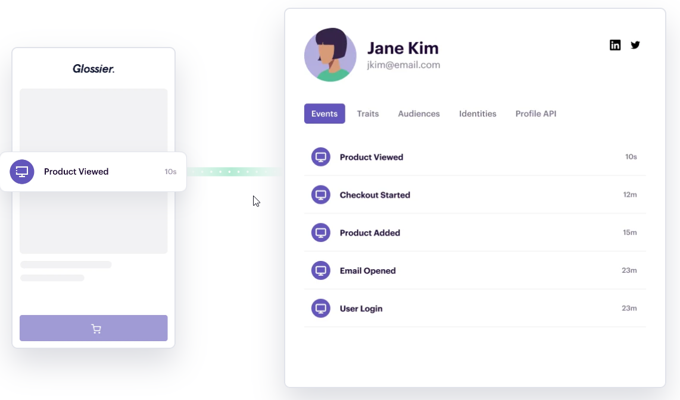
Customer Service

Slide 15
Cybersecurity
Threat Detection
*Darktrace SpyCloud
Authentication
*Bio Catch Autho
Fraud Detection
*Seon Persona
Notes:
Examples: Your AI has can block Phishing emails automatically so that you data can stay safe
AI can notice if a employee credentials are trying to be used to log in to company systems from a unknown access point and can ask specific questions to confirm that this person is who they say they are
AI can spot a fraudulent purchase being made on a customers CC but is shipping to a different country. The transaction can be blocked and notify you and the customer of a possible identity theft issue

Slide 16
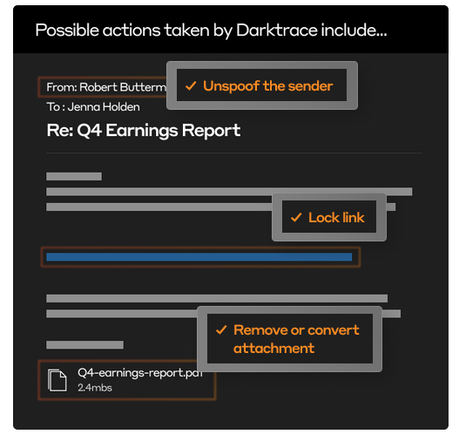
Cybersecurity

Slide 17
Hiring & Recruitment
Resume Screening
*Textio Modern Hire
Candidate Sourcing
*Entelo Eloomi
Onboarding
*Enboarder BetterCloud
Notes:
Examples: You got 25 resumes and with the help of AI you are able to sort the potential candidates based on certain criteria to help you find the top candidate for the position
AI can be your talent scout by scouring socials for candidates that are looking for a position like that one you are advertising for and can help direct them to you
You just hired on 5 new candidates and you do not have a full-time HR person. AI can help you gather the new hire paperwork for each candidate and can help you track where each new candidate is in the process

Slide 18
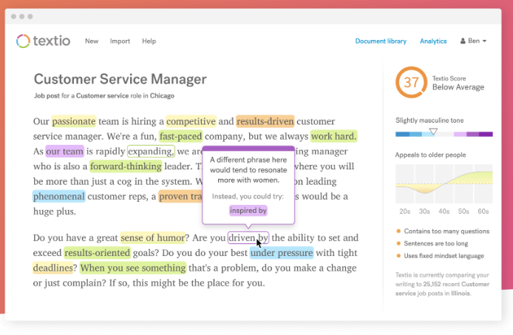
Hiring & Recruitment

Slide 19
Marketing
Content Creation
*Canva Anyword
Ad Targeting
*AdRoll Birdeye
Notes:
Examples AI can help you create and schedule Social media posts to promote your grand opening across several platforms
AI can help notice a trend in sales of a certain age group and will help you create specific ads to boost sales with that age group helping you stay relevant with that customer base

Slide 20
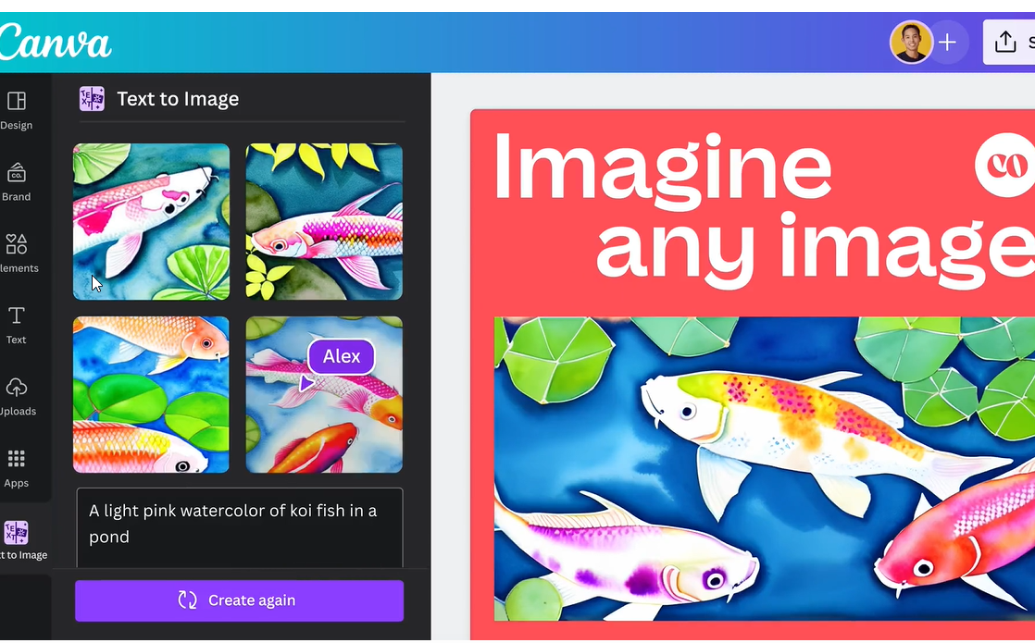
Marketing

Slide 21
Potential Drawbacks of Using AI in Small Business
Notes:
Same boxed responses can drive your customers crazy
Data training means that you have to have a backlog of data available for the program. This can leave you open to cyber attacks and data breaches
Sometimes you just want to talk to a human

Slide 22
AI Implementation Can Be Costly
Notes:
If you are looking to create a custom AI product to meet your business needs, this can take time to build as the program will need to be trained with historical data and will need to be tested. This typically take from 3-36 months but can at times take longer.
You will need to give the AI a constant flow of new data so that it is able to continue to learn

Slide 23
AI Can Be Technically Complex
Notes:
Code needs to be written for specialized programs that can take time as well
If your AI is having a issues with some data analysis it can take time to find the code that is in question and will take time to research the fix for a specialized system.
Frustrate your older customer base

Slide 24
AI Can Lack Human Touch
Notes:
Same boxed responses can drive your customers crazy
We have all been there on the phone screaming “Representative”

Slide 25
AI May Raise Data Privacy, Ethical, & Trademark Concerns
Notes:
(Above picture is AI Generated by DALL-E2)
Data training means that you have to have a backlog of data available for the program. This can leave you open to cyber attacks and data breaches
System is trained using words from the internet the AI can pick up on internet’s biases, stereotypes, and general opinions (fake news, conspiracy theories)
You will have to make sure that the training data is correct or you could be programming your AI with a vulnerability that can be exploited
Use as a tool and use your due diligence, make it your own

Slide 26
Current Examples of AI

Slide 27
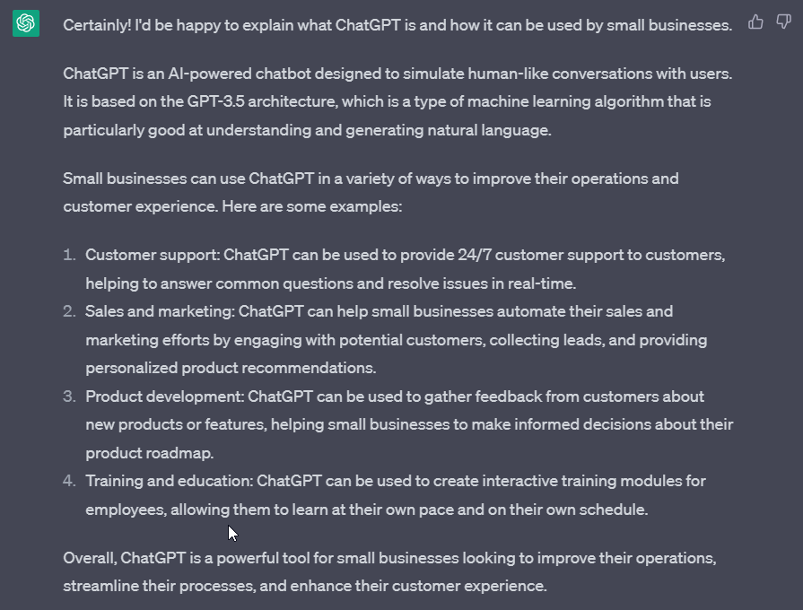
Chat GPT
Notes:
This is the program that has launched AI into the limelight.
This is Version 3 and only has access to data up until 2021 and not direct access to the internet
Version 4 is currently in Beta and will have the capability to access the internet for current data
Google is developing its on version of Chat GPT called BARD with apple working on developing its own as well
GPT-3 Parameters175 billion Supported Only Text 1500-2000 Words
GPT-4Parameters100 Trillion Supported Te x t and Image Words25,000 words

Slide 28
Synthesia #1 AI video creation platform
Notes:
AI video programs make it easy to create professional videos with out the expense of cameras, lighting , and audio and video editing programs. Can save Money for small business on a budget

Slide 29
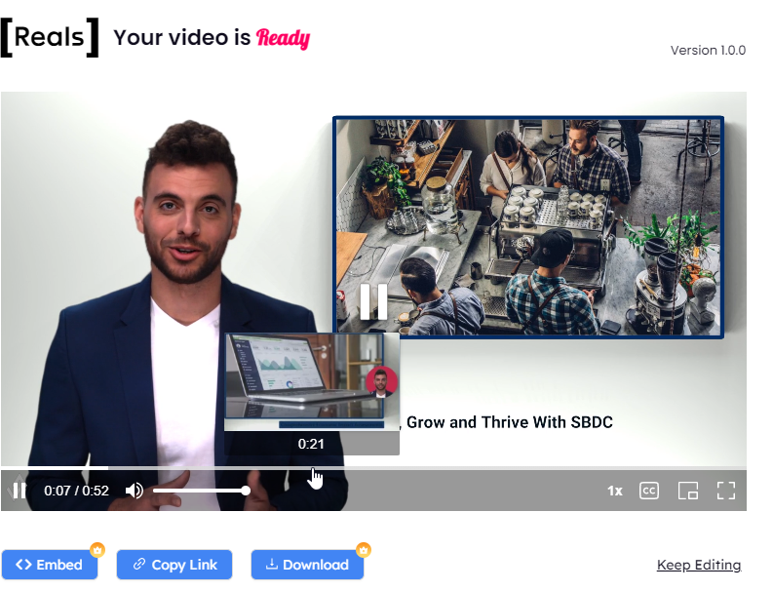
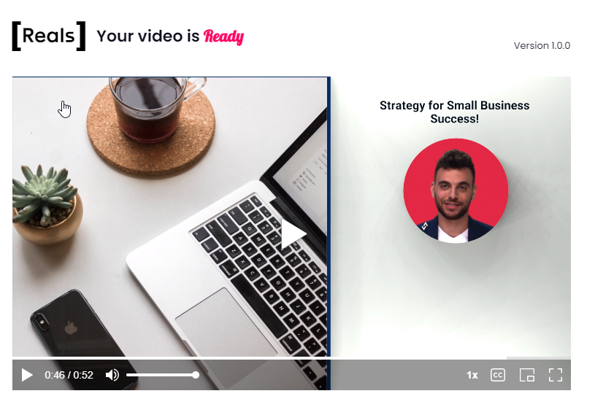
Reals AI AI video creation platform
https://app.hourone.ai/player/65b76ab707fb4d55b08fd2f8a6bb35f2
Notes:
You can have AI create a video presenter for your videos. You can even customize the avitar by uploading pictures of you and you can enter your voice as well

Slide 30
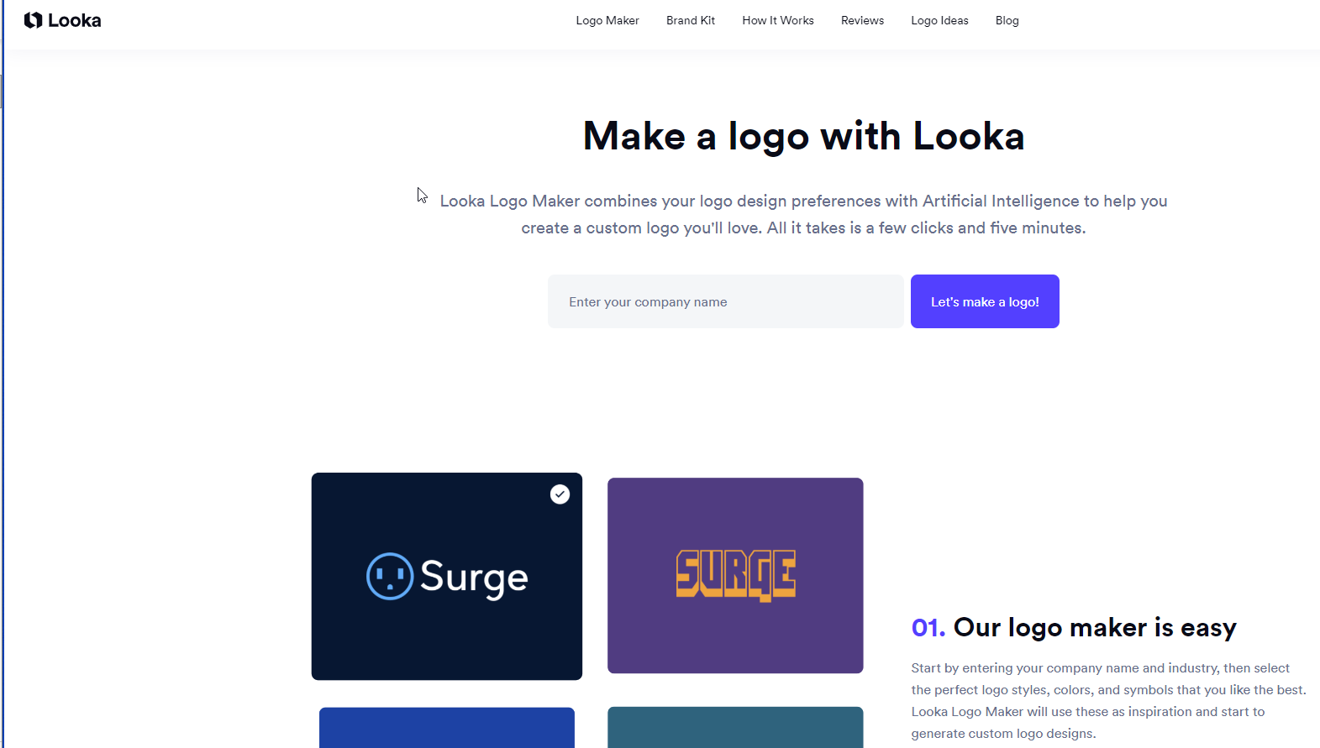
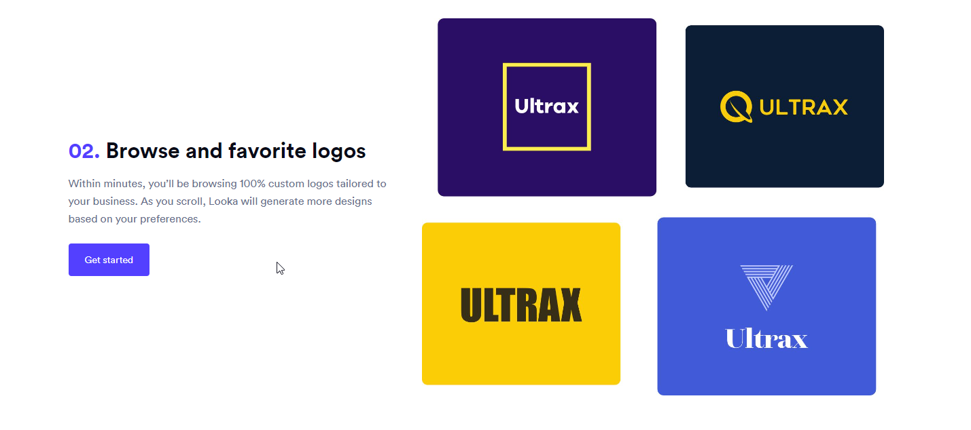
Looka AI-powered logo design program
Notes:
Have AI create your look by helping you generate a logo for your business. Some simple data entry and your business name and it can come back with unique logo ideas you can chose from

Slide 31
Pictory AI Text To Video
Notes:
Simply add a script and AI can create a video with sceens and voice over with background music in no time
This video comes from a blog post that is currently posted on our website. All that was done was cut and pasted the article in the text box and the AI program created the video that is above
This would be good used as a tutorial or onboarding (orientation)videos

Slide 32
DALLE-E2 AI Generated Images
Notes:
Completely unique pictures created by AI with some text prompts entered by you

Slide 33
Microsoft Copilot Whole New Way To Work
Notes:
Both Google and Apple are working on their own programs to rival Copilot

Slide 34
Artificial Intelligence Resource List
General Management
Scheduling
You Can Book Me: https://youcanbook.me/ Calendly: https://calendly.com/
Email Management
Boomerang: https://www.boomerangapp.com/ Hiver: https://hiverhq.com/
Social Media Management
Constant Contact: https://www.constantcontact.com/ Hootsuite: www.hootsuite.com
Accounting
Bookkeeping
Wave: https://www.waveapps.com/ QuickBooks: https://quickbooks.intuit.com/
Financial Analysis
Spotlight: https://www.spotlightreporting.com/ ClicData: https://www.clicdata.com/
Expense Management
Expensify: https://www.expensify.com/ Zoho expense: https://www.zoho.com/us/expense/expense-reports/
Customer Service
Chatbots
Intercom: https://www.intercom.com/ Birdeye: https://birdeye.com/
Personalization
Segment: https://segment.com/ Insider: https://useinsider.com/
Customer Insights
Adobe Insight: https://business.adobe.com/ Resonate: https://www.resonate.com/
Cybersecurity
Threat Detection
Darktrace: https://darktrace.com/ Spy Cloud: https://spycloud.com/
Authentication
BioCatch: https://www.biocatch.com/ Autho: https://auth0.com/
Fraud Detection
Seon: https://seon.io/ Persona: https://withpersona.com/
Hiring & Recruitment
Resume Screening
Textio: https://textio.com/ ModernHire: https://modernhire.com/
Candidate Sourcing
Entelo: https://www.entelo.com/ Eloomi: https://eloomi.com/
Onboarding
Enboarder: https://enboarder.com/ BetterCloud: https://www.bettercloud.com/
Marketing
Content Creation
Canva: https://www.canva.com/ Anyword: https://anyword.com/
Ad Targeting
AdRoll: https://www.adroll.com/ Birdeye: https://birdeye.com/
Chat GPT: https://openai.com/
Synthesia: https://www.synthesia.io/
Reals AI: https://app.hourone.ai/
Looka: https://looka.com/
Pictory AI: https://pictory.ai/
DALLE-E2: https://openai.com/product/dall-e-2

Slide 35
Small Business Development Center
Connect with us!
Sue Pitts
Josh Baker
Center Director
SBDC Coordinator
Spitts@iwcc.edu
712-325-3350
www.iowawesternsbdc.com
jbaker@iwcc.edu
712-256-7728

