Slide 1
Boosting Your Small Business Visibility: SEO and Local Search

Slide 2
What is SEO (search engine optimization)
SEO - Defined
Search Engine Optimization (SEO)
The marketing discipline focused on growing visibility in organic (non-paid/free) search engine results. SEO is not only about building search engine friendly websites. It is about making your site better for humans too.
NOT
Pay Per Click (PPC) or Search Engine Marketing (SEM)
A pay-per-click or Search Engine Marketing involves having individuals (advertisers) pay for positioning in search results. Each time someone clicks through to the listed web site, the search engine charges the advertiser.

Slide 3
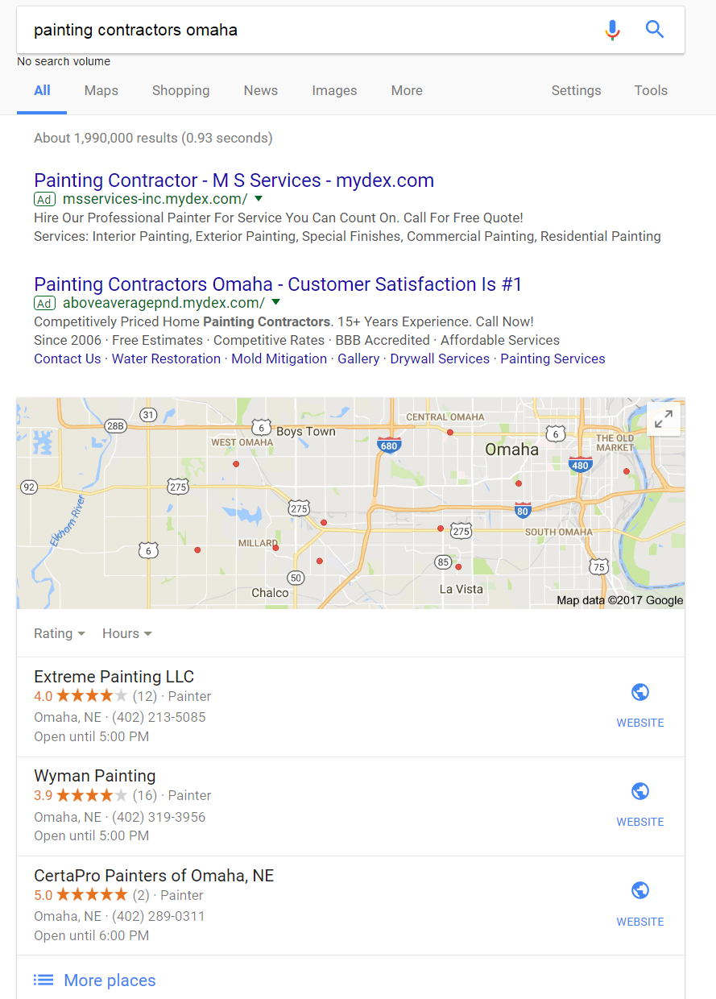
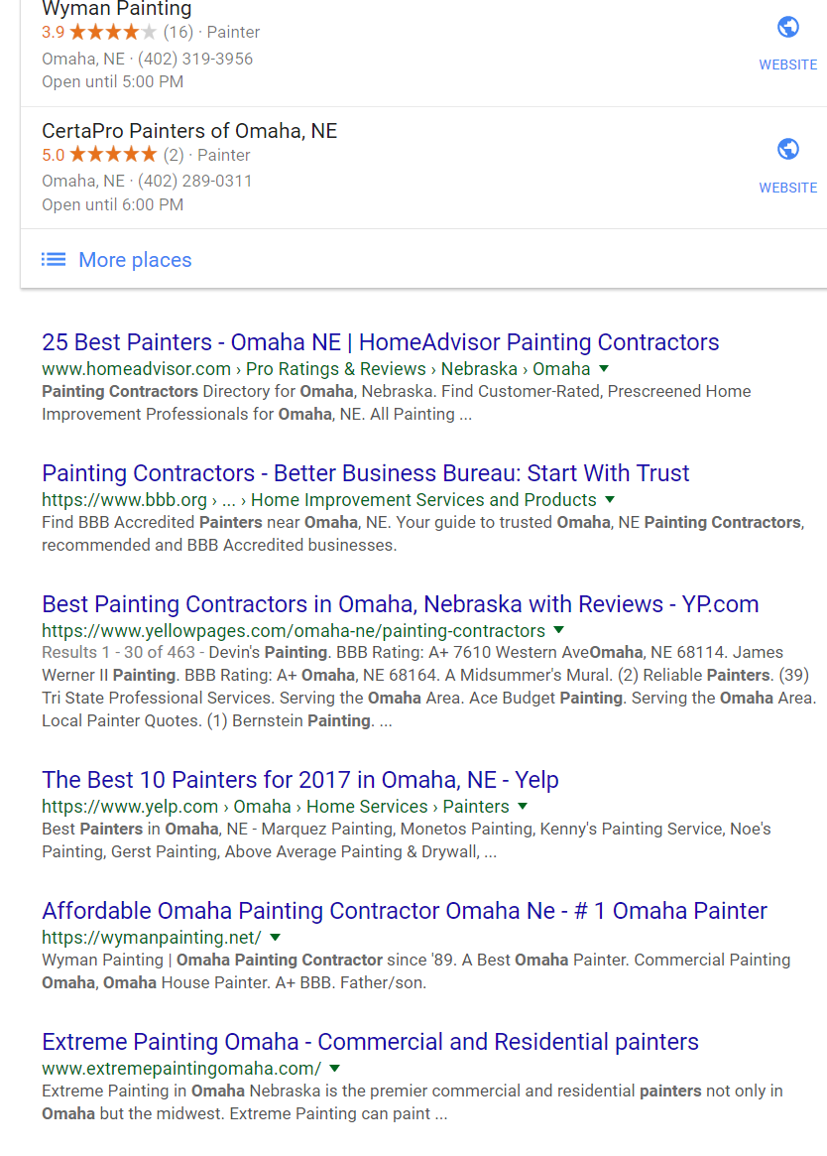
Notes:
Notice that google does not usually have thiings on left for local searches.

Slide 4
What is SEO (search engine optimization)
How Search Engines Work
A search is conducted by entering a keyword/phrase into search engine
Search Engines Crawl and Index content on the web looking for keyword or phrases (websites, blogs, pdfs, etc.)
Content
Structure
Links
Key Word Phrase

Slide 5
What is SEO (search engine optimization)
How Search Engines Work
Search engines provide answers based on an algorithm that involves
Keywords
Relevance
Importance (Links & Shares) and more…

Slide 6
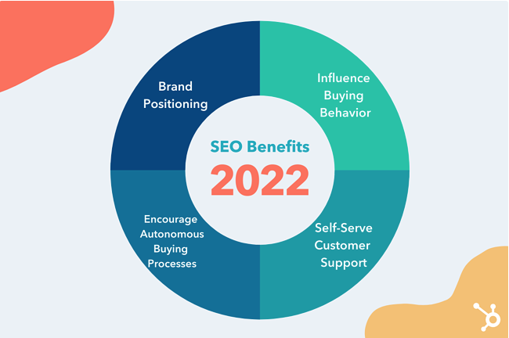
What is SEO (search engine optimization)
The Importance of SEO
Helps customers find what they are looking for when they want it
Positions your business through the entire buying journey
92% of internet searches happen on a google property
SEO supports new buying behavior – going through the majority of buying process on their own
Image and information from https://blog.hubspot.com/marketing/seo

Slide 7
What is SEO (search engine optimization)
The Buying Process
Use google when we have a problems and looking for solutions
Use Google to evaluate and exhaust all potential solutions
Inquire with company last
The only chance for customers to notice and even consider your bushiness is to show up in Organic or Local search results.

Slide 8
Three Core Components
Technical Setup
Content
Links

Slide 9
1. Technical Setup
Google only sees text. Technical setup will ensure that your website will allow google to scan and index it.

Slide 10
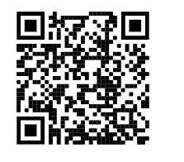
Important Factors
Website navigation and links – text only
Simple URL structure – keep short with main keyword
Page Speed – Google’s Page Speed Insights Tool
Dead links or broken redirects
Sitemap and Robots.txt files
Duplicate content
Text – not pictures for keywords

Slide 11
2. Content
When we use a search engine we are searching for content. Web pages, blogs, videos, reviews, listings. It is all content
It is what customers want. The more you publish the better you will be found
SERPS use content to determine page rank. How close are searches to content on a page.

Slide 12
Who is Visiting Your Website
Beyond Demographics
Describe Life/Business Situation
What is the pain
Where Are They?
What do they read
What sites do they visit?
How do they search in Google?
What Do They Want?
Overall Value Statement – Elevator Pitch
Basics – Price, Contact Info, About , Testimonials/reviews, etc.
What do they NOT care about (eliminate from site)
How does your site/product/service BENEFIT them

Slide 13
Elevator Pitch
The home page should answer quickly:
Who are we
What do we do
What can you (visitor) do here?
What is the Value Proposition
What is your Unfair Advantage
Is their a Niche market you can explore

Slide 14
Discover Keywords
What are Keywords?
Words that your customers use when trying to solve the problem they are having.
As a website owner and content creator, you want the keywords on your page to be relevant to what people are searching for so they have a better chance of finding your content among the results.
Small Business Help in Iowa

Slide 15
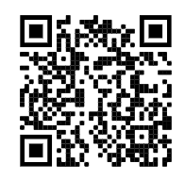
How Are They Searching
Discover Keywords
LAWYER
ATTORNEY
Use Search Tools
Survey Customers
Study Competition
Pay attention to vocabulary
Start General to Product Specific
List Words, Short Phrases and Long Tail
The Riches are in the Niches
How to Do Keyword Research by HubSpot

Slide 16
Keyword Tools
Discover Keywords
Google Keyword Planner –
Search for new keyword ideas
Search Volume
Traffic forecasts for lists of keywords
KW Finder (Free for 3 searches daily)
Trends
Volume
Level of Difficulty
Long Tail
Moz’s Keyword Explorer (3 searches daily)
Keyword suggestions
SERP Results and opportunity
Importance to your campaign
Potential
Keyword Tool – (Free but limited)
Google Auto Complete Data
Notes:
With Keyword Planner, you can:
Search for new keyword and ad group ideas
Get search volume for a list of keywords or group them into ad groups
Get traffic forecasts for a list of keywords
Multiply keyword lists to get new keyword ideas
You should pay attention to keyword ideas and ad group ideas, as both can help with SEO. Ad group ideas contain a set of related keywords that might not show up in general keyword ideas.
Pay attention to average monthly searches, competition, and other available metrics to determine relevant keywords to target.
If you plan on doing SEO and PPC together, Keyword Planner can help you determine which keywords are better to target organically or with advertising.
You can also use Keyword Planner’s suggestions as a base to build long tail keywords with the help of some of the other tools below.

Slide 17
Main Keywords
On Page SEO
What Keywords are featured on each page
Headlines
Anchor Links
Body
What Keywords SHOULD be featured on each page
Home Page - General Business/Value Proposition
Every Other Page – A unique keyword focus
Every Page Should Have a Keyword Focus (use dropdown menus)
Each Major Product Category
Each Location- but no duplicate content
New Content should be keyword focused
Blogs
Email
Downloadable Content

Slide 18
Title Tags
On Page SEO
A title tag is an HTML element that specifies the title of a web page. Title tags are displayed on search engine results pages (SERPs) as the clickable headline for a given result, and are important for usability, SEO, and social sharing.
The title tag of a web page is meant to be an accurate and concise description of a page's content.

Slide 19
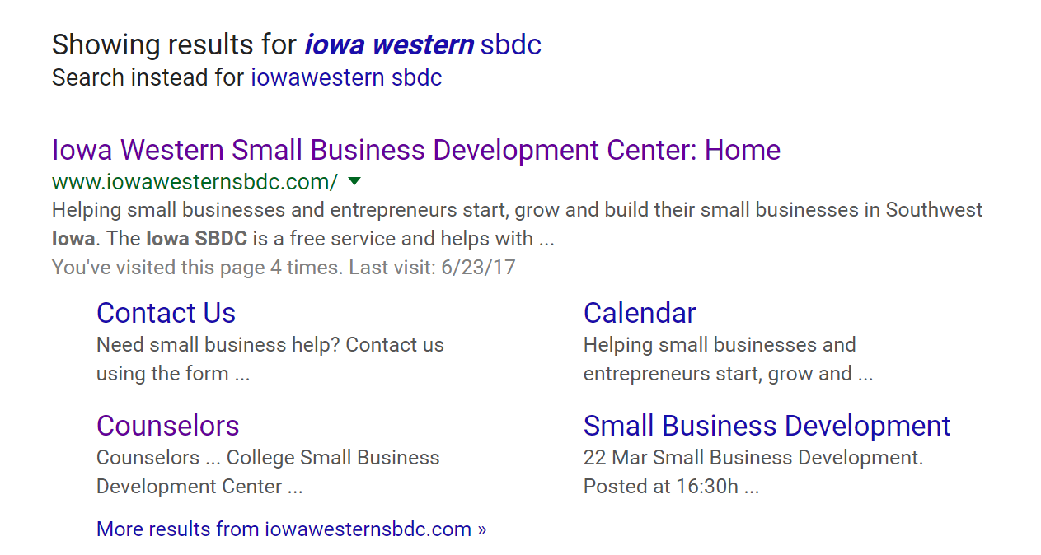
Title Tags
On Page SEO

Slide 20
Title Tags – Why Do They Matter?
On Page SEO
Search Engine Spiders use them to understand what the page is about
Search Engine Results Page
Web Browsers – Placeholder
Social Networks – Link Title

Slide 21
Title Tags – How to Write
On Page SEO
Optimal Format – Primary Keyword – Secondary Keyword | Brand name
Small Business Help Southwest Iowa – IWCC SBDC
Optimal Length – 50 to 60 Characters
Unique for EVERY page
Don’t overdo Keywords
Write for customers
Important Keywords First
If you are local – local words are important

Slide 22
Description Tag
On Page SEO
The Description Tag is an HTML attribute that summarizes the meaning and purpose of a webpage

Slide 23
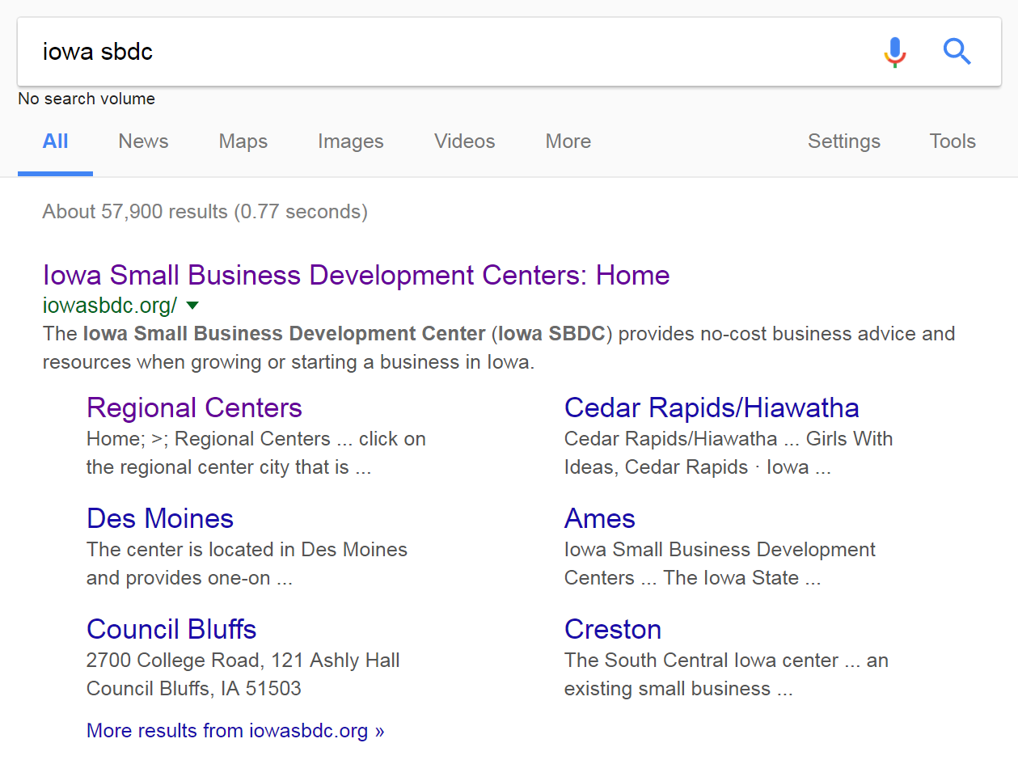
Description Tag
On Page SEO

Slide 24
Description Tag
On Page SEO
Optimal Format – Clear Concise Message that will entice searcher to click through
Naturally use keywords that the page is focused on in a non spammy way
Optimal Length – 160 characters or less
Unique for EVERY page
Don’t overdo Keywords
Write for customers

Slide 25
Description Tag
On Page SEO
Shows up in SERP under title of Listing
Write compelling Ad Copy
Avoid duplicates

Slide 26
Header Tags – H1, H2, …
On Page SEO
The Header Tags defines the heading on a website as most important. Most important = H1, next important, H2 and so on

Slide 27
Header Tags – H1, H2, …
On Page SEO
Unique descriptive H1 tag
H1 should communicate the pages main purpose
Include 1 or 2 high level keywords
Sub headers (h2,h3…) target secondary keywords
Break up content/organize
Avoid generic phrases “more info”

Slide 28
Navigation
On Page SEO
Internal Links/Anchor Text
Links that point to more content on the same domain
Helps with site organization
Helps users find information
Use Exact Match – Services(anchor) links to Services(page)
External Links
Linking out to other relevant pages.
Provides good user experience
Positions your content as a valuable resource

Slide 29
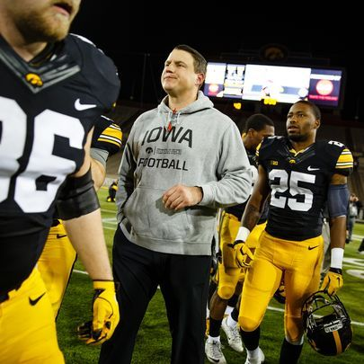
On Page SEO - More
Photos/Alt Tags
Describes the appearance and function of an image
Web accessibility (vision impaired)
Loading Issue
Provide image/context information to Search Engines
Precise/descriptive
Not spammy
Eyes closed test
Alt Text: Iowa offensive coordinator Brian Ferentz walks off

Slide 30
Good Page Content
Content/User Experience
Google has stated that content is one of its top three ranking factors
Communicates what each page is about
Useful, informative, unique, original
Targeted to ideal customer
Shareable
Better than competitors
Engage – You, Yours Ours
Natural use of keywords
Focused on main keyword

Slide 31
Content Best Practices
Content/User Experience
Keep the page easy to navigate and offer the information that the customer is really looking for. Eliminate (or bury) the information they don’t care about.
Contact Page
Contact Information on Every Page
About Page
Call To Action
Navigation
Anchor Link Navigation
Imperative Information– Price, Phone, Address, etc.

Slide 32
Inbound Links
Off Page SEO
A link coming from another website to your own website. Links tell Google that your website is an authority on a certain subject
From a authoritative source
Relevant to the topic
Avoid the Five B’s (borrowing, begging, bartering, bribing, or buying)
Gain links by creating content, having a good business, networking and becoming an influencer

Slide 33
Social Media
Off Page SEO
Social Media indirectly increase a sites rankings by driving people to your site, sharing posts, creating new inbound links and generally making you an authority.
Connect social media to website
Maintain website as the HUB
Create engaging/shareable content

Slide 34
Mobile Optimization
Off Page SEO
The process of ensuring that visitors assessing your website from a mobile device have an engaging and user friendly experience.
Start with Google Mobile Friendly
Responsive design
Page loading speed
Mobile design and usability

Slide 35
Local Search Optimization
Local SEO
A search performed online in which a person is looking for a business, product or service near where they live or in an area they will be.
Claim and manage Google Business Profile
Reputation management.
Website optimization
42% of all Google searches are local searches

Slide 36
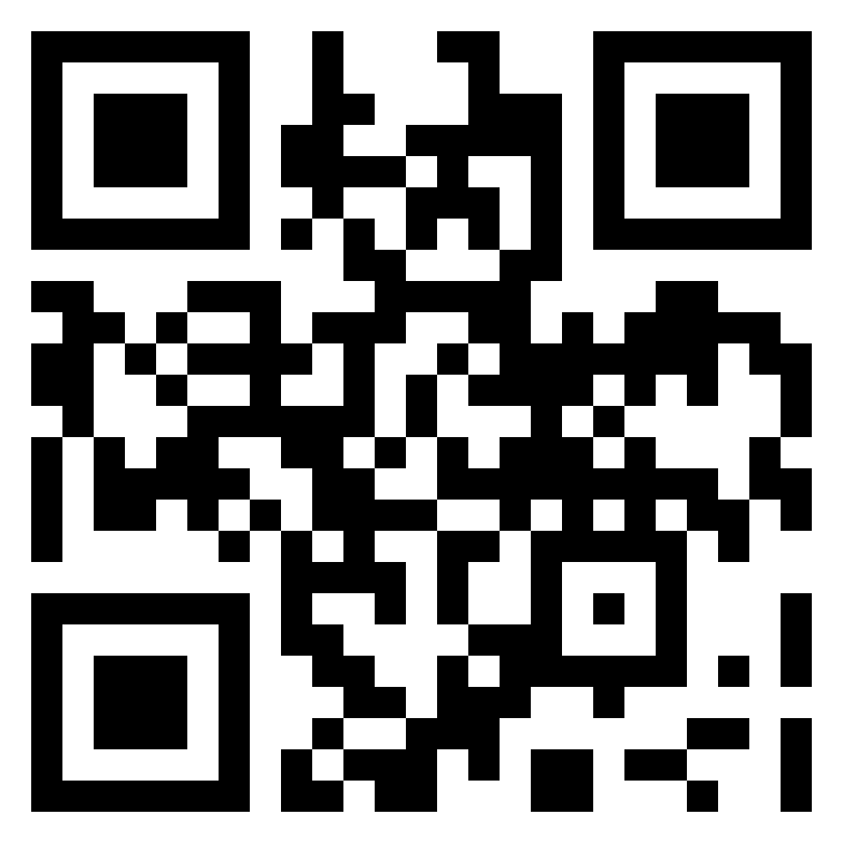
Google Business Profile
Local SEO
Claim and manage Google Business Profile www.google.com/business
Verify via postcard
Create and manage listing through your google account (Gmail)
Utilize photos, menus, hours, q & A, Google posts
Office address or Area
Google reviews.

Slide 37
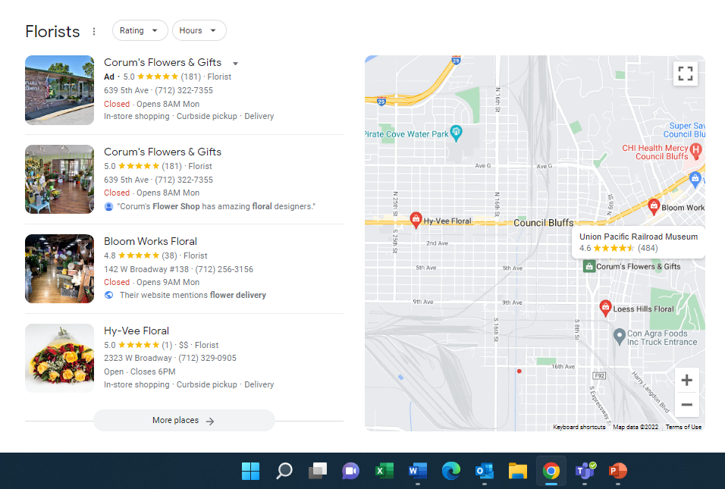
Google Business Profile
Local SEO

Slide 38
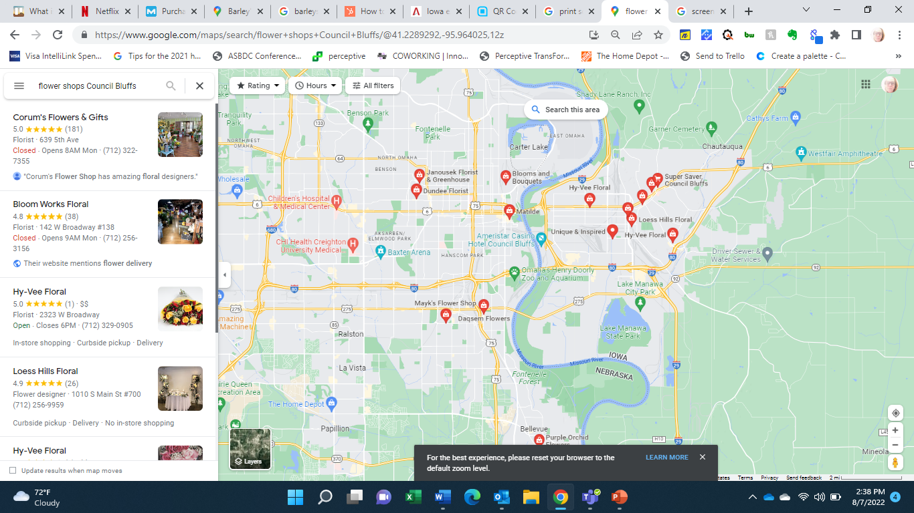
Google Business Profile
Local SEO

Slide 39
Reputation Management
Local SEO
Google reviews priority one
Industry based reviews (Yelp) etc)
Social media reviews
Manage reviews regularly
Respond
Request

Slide 40
Optimize Website
Local SEO
Add local keywords and content
Optimize your mobile site
Multiple locations – create pages for each
Avoid duplicate content

Slide 41
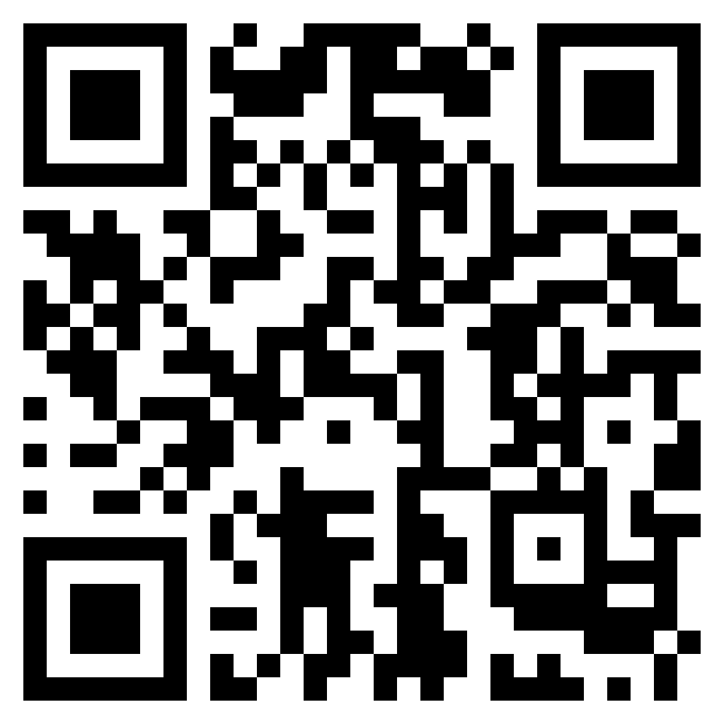
Citations
Local SEO
Mentions of you business name, address, phone number and website
Check your listing through moz
Make sure you are consistent with NAPW
Social
Directories
Local Directories (chambers, etc)
Industry Directories

Slide 42
Contact
www.iowawesternsbdc.com
Sue Pitts – Center Director
spitts@iwcc.edu
712-325-3350
Joshua Baker
712-256-7728
jbaker@iwcc.edu
www.facebook.com/iwccecenter

